Slide 1
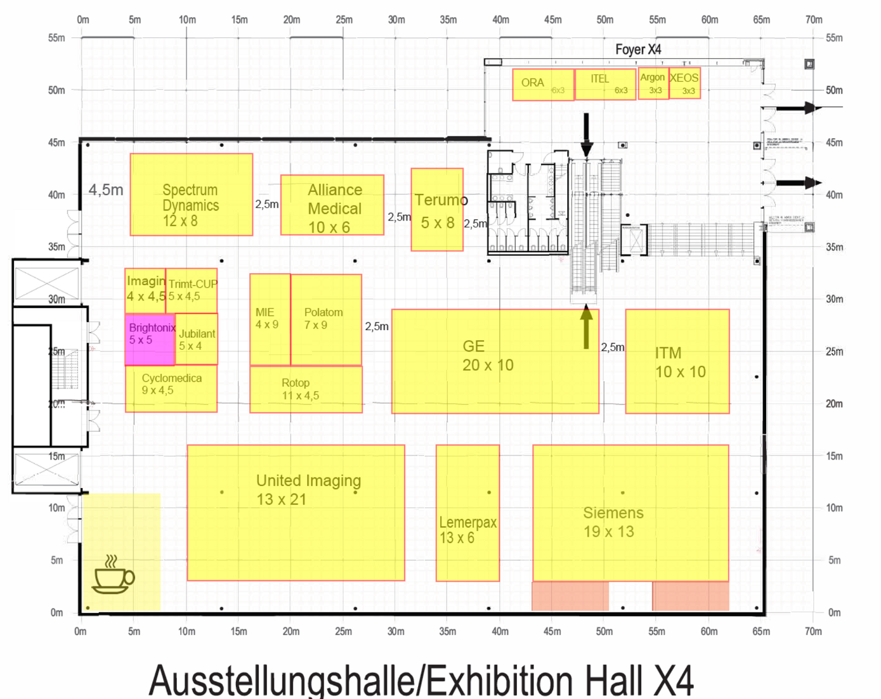
Floor plan

Slide 2
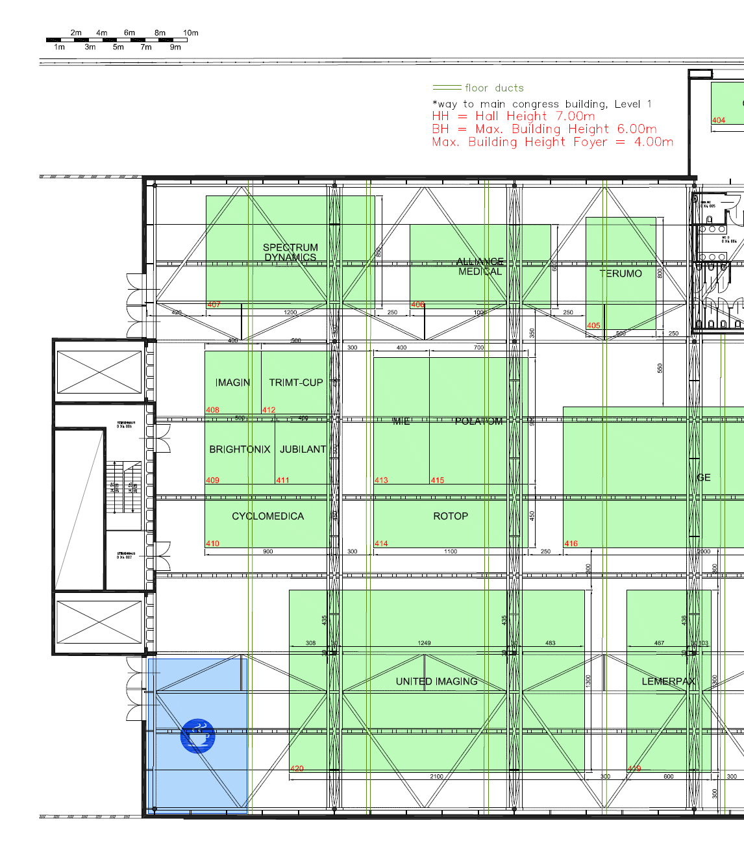
Ceiling plan

Slide 3
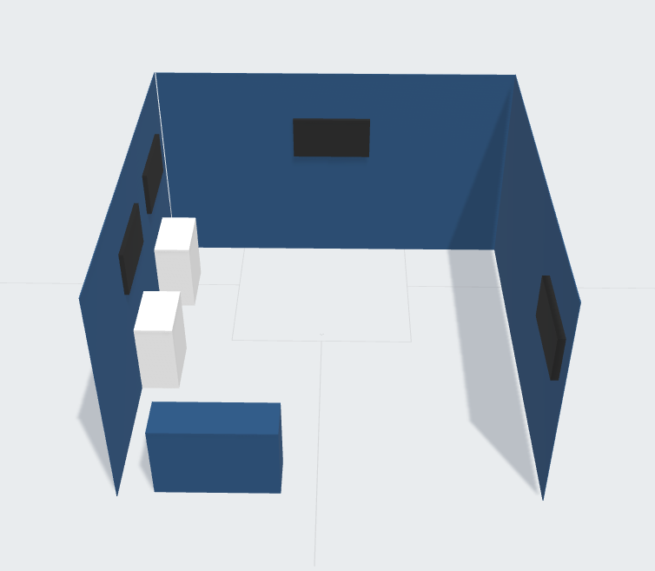
5m x 5m
inline booth laylout

Slide 4
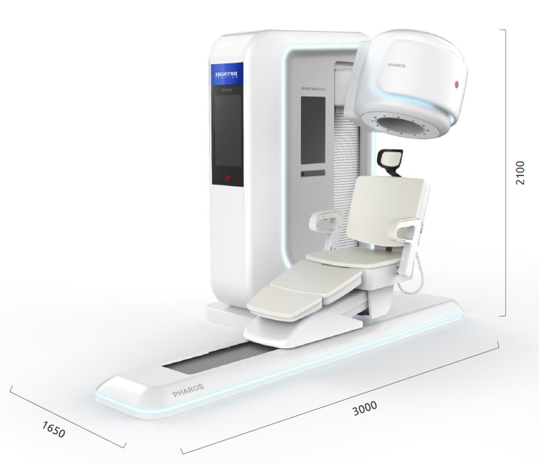
Units are in centimeters
1. Booth items
Platform:
25sqm x 5H raised floor with dark gray carpet
Graphics:
(1) 5m x 5m x 100H double sided square hanging banner
(3) Wall graphics
Furnitures:
(2) Counters for demo stations
(4) High chairs
(1) Reception
Visuals:
(4) 50” wall mounted TVs
Electricity:
Electricity powers – we need (1) separate plug for our display machinery product
Booth lighting
2. Display machinery product
- The product will be placed in the middle of the booth

