Slide 1
ESCIM Congress
29 – 2 octobre 2019
Berlin Cube

Slide 2
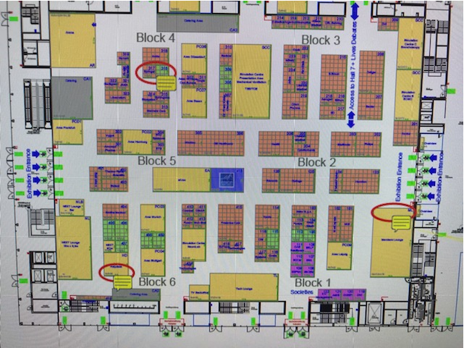
Exhibitor plan
Cheetah Medical
Location
18sqm
Open on 3 sides

Slide 3
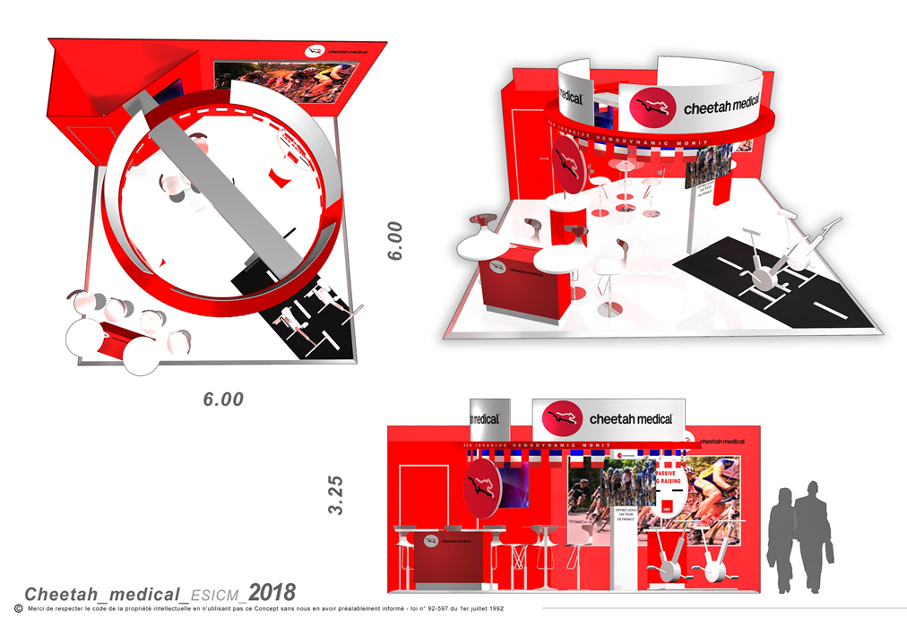
Past congress
Red colour
Product monitor for
hemodynamic monitoring
Need for a screen
No much need for chair, may be one counter

Slide 4
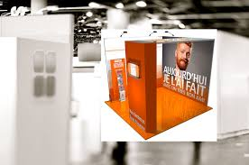
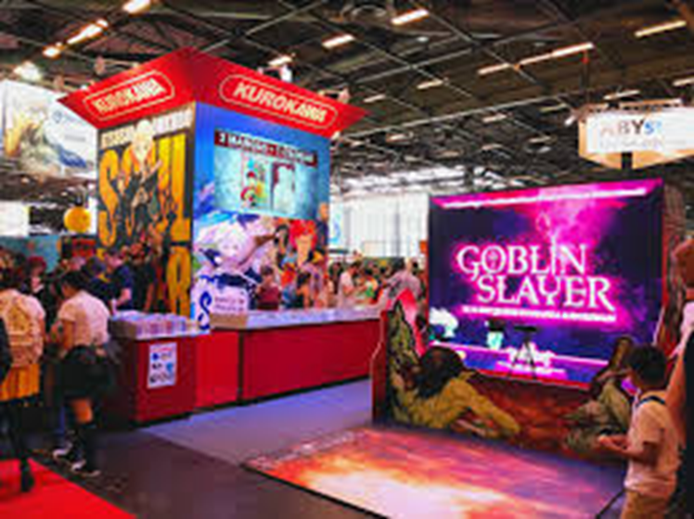
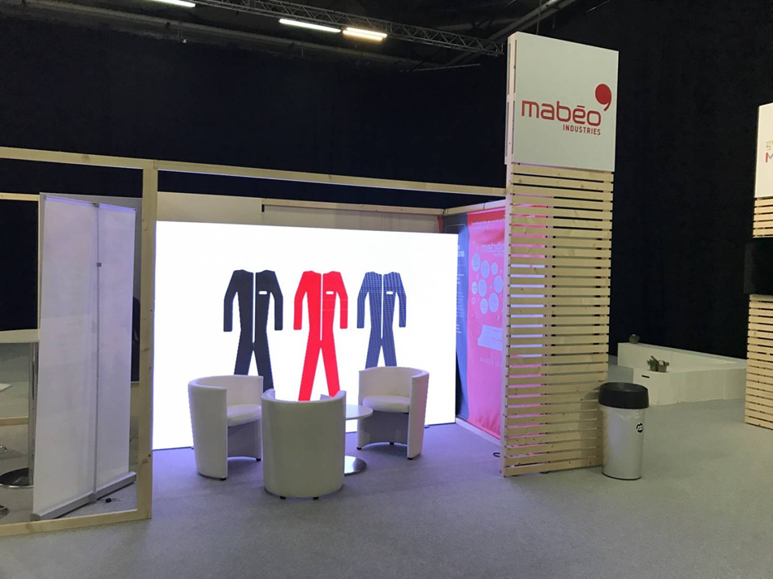
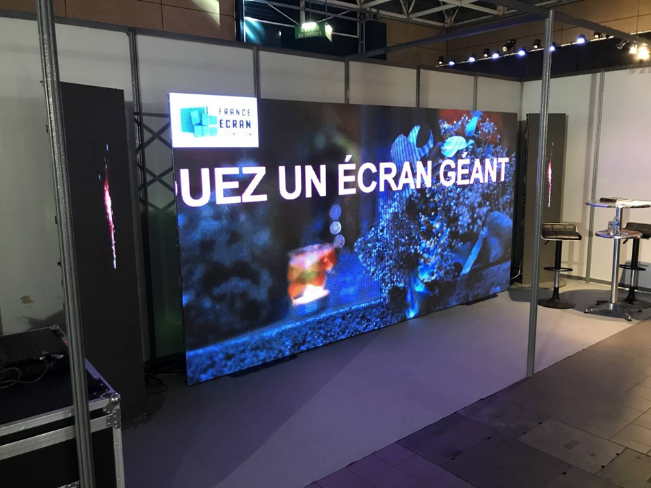
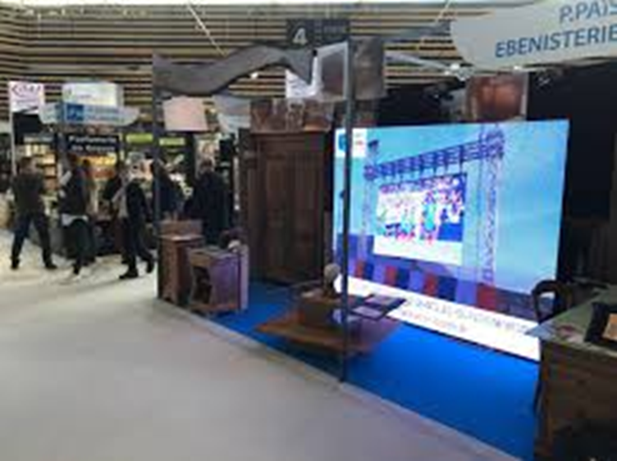
Some ideas I have found on the web

