Slide 1
FEATHR
Stand Build Brief
Heimtextil 2020 Frankfurt Germany

Slide 2
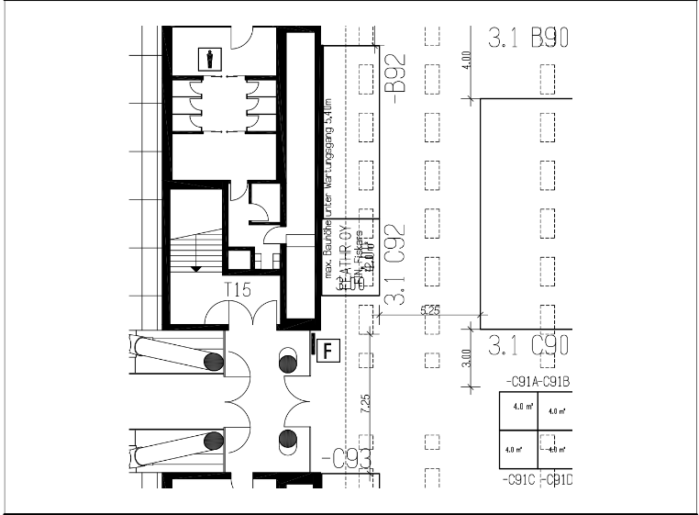
Stand details
Hall 3.1 C92
2 sides open
Depth 300cm
Width 400cm
Total 12 sqm

Slide 3

Overall look and feel
Black undercoat
Free standing panel walls that run across the ceiling to the other side of the stand

Slide 4
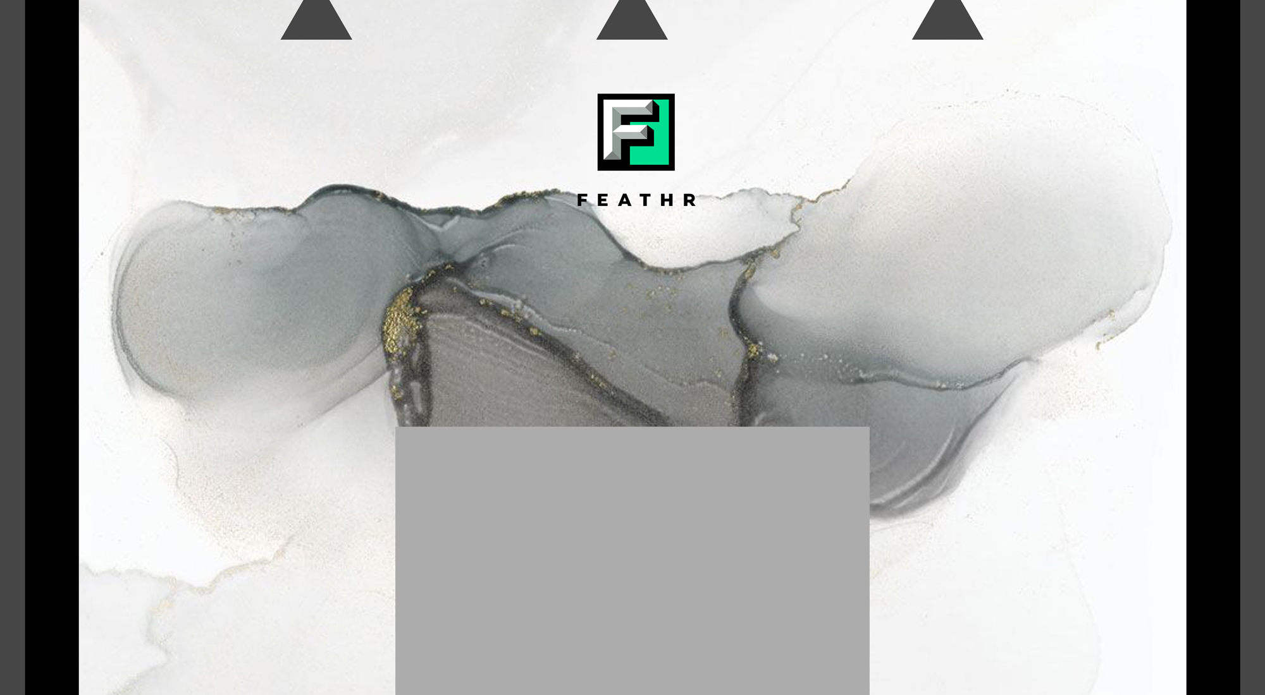
View from the front towards back wall
400cm wide
Black paint 15cm wide
Black paint 15cm wide
Back wall has wallpaper
Client will hung the
wallpaper
Contractor builds a flat
background surface
and paints the sides black
Min
300cm
high
150cm wide
Contractor builds the table
Table in the middle of floor
Needs storage
space inside
100cm high
Strip of black skirting board to frame the wallpaper. Installed after the wallpaper has been hung

Slide 5

View from the left (open) side towards the stand
Client takes care of all wallpapering except the
Ceiling which needs to be done by contractor
Black skirting board
Installed on top of wallpaper
300cm
Front
Back wall
front
Table 100cm wide
Table visible
Needs to be
centered
33cm
Wallpapered free standing
wall 100cm
Empty space 33cm
Between walls
Wallpapered wall
100cm
33cm

Slide 6
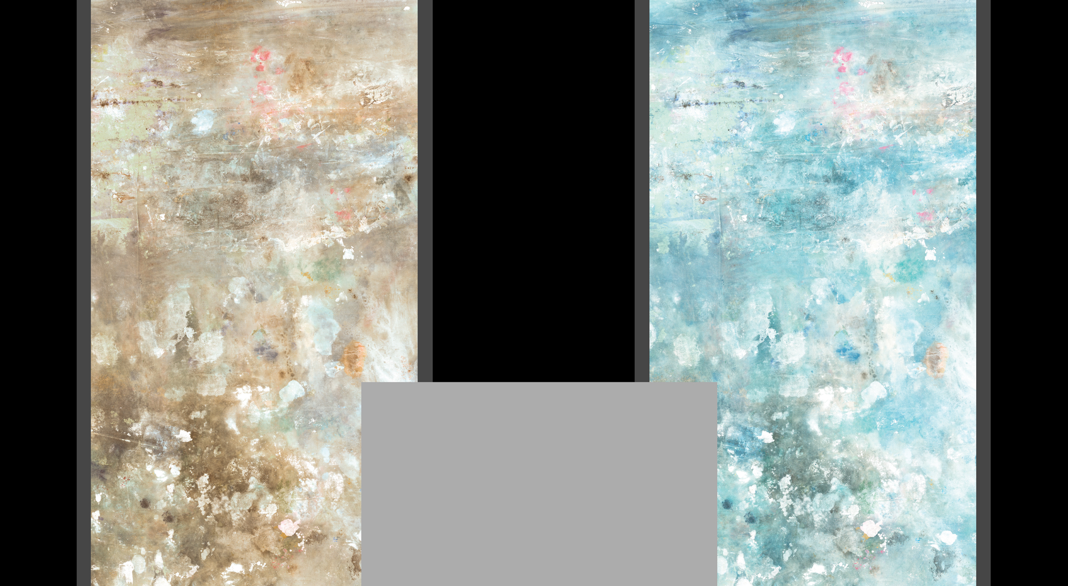
View from inside towards the open left wall
300cm
33cm
33cm
33cm
All wall sides
need to be
painted
black
table
Black skirting board to frame the wallpaper. Installed after we have hung the wallpaper

Slide 7
View from inside towards the right wall (against neighbour stand)
Panel walls continue
down from the ceiling
About 5cm thick
100cm
33cm
100cm
33cm
33cm
Edges of the
panel wall
need to be
painted black
Wall behind the
panel walls needs
to be painted
black
table
Black skirting board to frame the wallpaper. It is installed after we have hung the wallpaper
300cm

Slide 8

View from sky down to the stand
Side walls continue as roof panels across the stand space to the other side of the stand
400cm
Back wall
33cm
100cm
Side corridor
33cm
Table top
300cm
100cm
33cm
The edges that are visible from
below need to be black
Front corridor

Slide 9
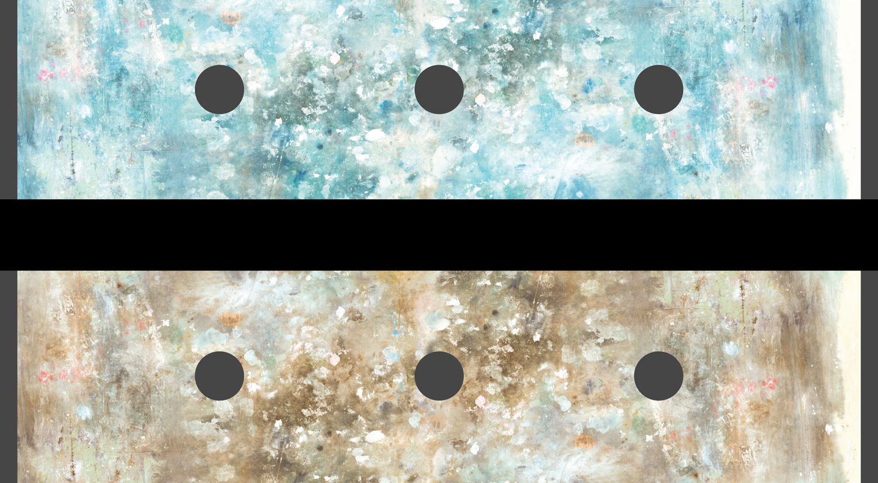
View from inside the stand towards ceiling
33cm
400cm
100cm
33cm
Wall against the neighbour stand
All ceiling
edges
need to
be black
100cm
33cm
Lighting
Ordered and installed
by contractor
Ceiling wallpaper hung by
contractor

