Slide 1
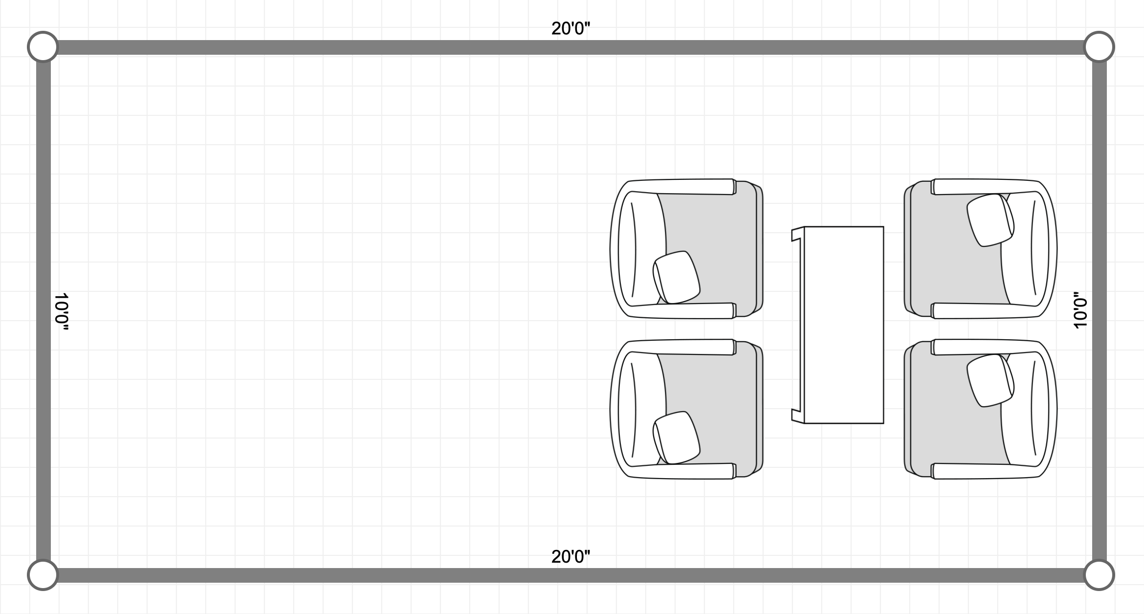
STAND
MONITOR
PLANT
HIGH TABLE
GREETER
IPAD

